Slide 1
ZooKill Soccer
A Game Design Document
Created by: Elvis Lopez

Slide 2
Game Design Document - 1
Animals are breaking out of their Zoo Cages!
Your job is to kick Trump like a soccer ball so that he collides with a Zoo Animal
If you successfully kick Trump into the path of an escaping Zoo Animal, it will “do what it will” to Trump and return to its cage
Otherwise, the Zoo Animal will come after YOU.

Slide 3
Game Design Document - 2
Sequence
At the start of the game, the cages open
Animals drift down the screen to attack you
You have a Trump which you can kick into their path
Each animal who collides with Trump is satisfied, and returns to its cage
An animal who makes it past Trump will attack YOU (game over)

Slide 4
Game Design Document – 3
Each time Trump runs into an Animal, he loses a “life”
Trump has 3 lives, but there are 4 animals (so you can’t win)
In addition to Animals, a “health” object floats down the screen (Trump name, $$ signs, helpful Animals)
If you kick your Trump into the “health” object, it restores Trump’s health
You need have Trump connect with at least 1 “health” object to win the game

Slide 5
Game Design Document - 4
You WIN the game by returning all animals to their cages, while Trump is still functional
You LOSE the game if Trump becomes non-functional, in which case an Animal gets into the Player zone.

Slide 6
Screens
Start Screen
Game Screen
Win/Lose Retry/High Scores Screen

Slide 7
The Characters – All Screens
The Player (your foot, since your kicking Trump like he was a soccer ball). Possibly “skinned” with different images (e.g. Bernie Sanders)
The Animals (4 of them, in cages at the top of the screen, Lions, Tigers, Bears, Gorilla)
The Trump (next to your foot at the start so you can kick him but possibly could exit the screen if you don’t keep kicking him into the upper region of the screen
The Health Object (floats down the screen) restores Trump health if he collides with them
The Zoo (Arena, contains
Cages /w Animals
Animal + Trump + Health Object movement area (down the screen)
Player movement area (back and forth)

Slide 8
Interactions – Game Screen
Player
Trump (kicks him into Animal Area)
Animal (if it goes into Player Area, lose game)
Trump
Player (gets kicked into Animal area)
Animal (rebounds Animal into Cage, but loses Health)
Health (restores Health)
Animals
Cage (don’t move while in Cage)
Trump (go back to cage after Trump encounter, damage Trump)
Player (if they get into Player area, the trigger a “game lost”)
Health
Trump (restores Trump health on collision)
Zoo/Cage
Keeps Animals from moving
Zoo/Animal Area
Allows Animals, Trump, Health to move
Allows collisions between Animals, Trump, Health
Zoo/Player Area
Allows Player to move
Detects if Animal entered region, if so, ends game

Slide 9
Interaction Matrix-Game Screen
 | PLAYER | TRUMP | ANIMALS | HEALTH | ZOO/CAGE | ZOO/ANIMAL AREA | ZOO/PLAYER AREA
PLAYER | - | + | + | - | - | - | +
TRUMP | + | - | + | + | - | + | +
ANIMALS | + | + | - | - | + | + | +
HEALTH | - | + | - | - | - | + | -
ZOO/CAGE AREA | - | - | + | - | - | - | -
ZOO/ANIMAL AREA | - | + | + | - | - | - | -
ZOO/PLAYER AREA | + | + | + | - | - | - | -

Slide 10
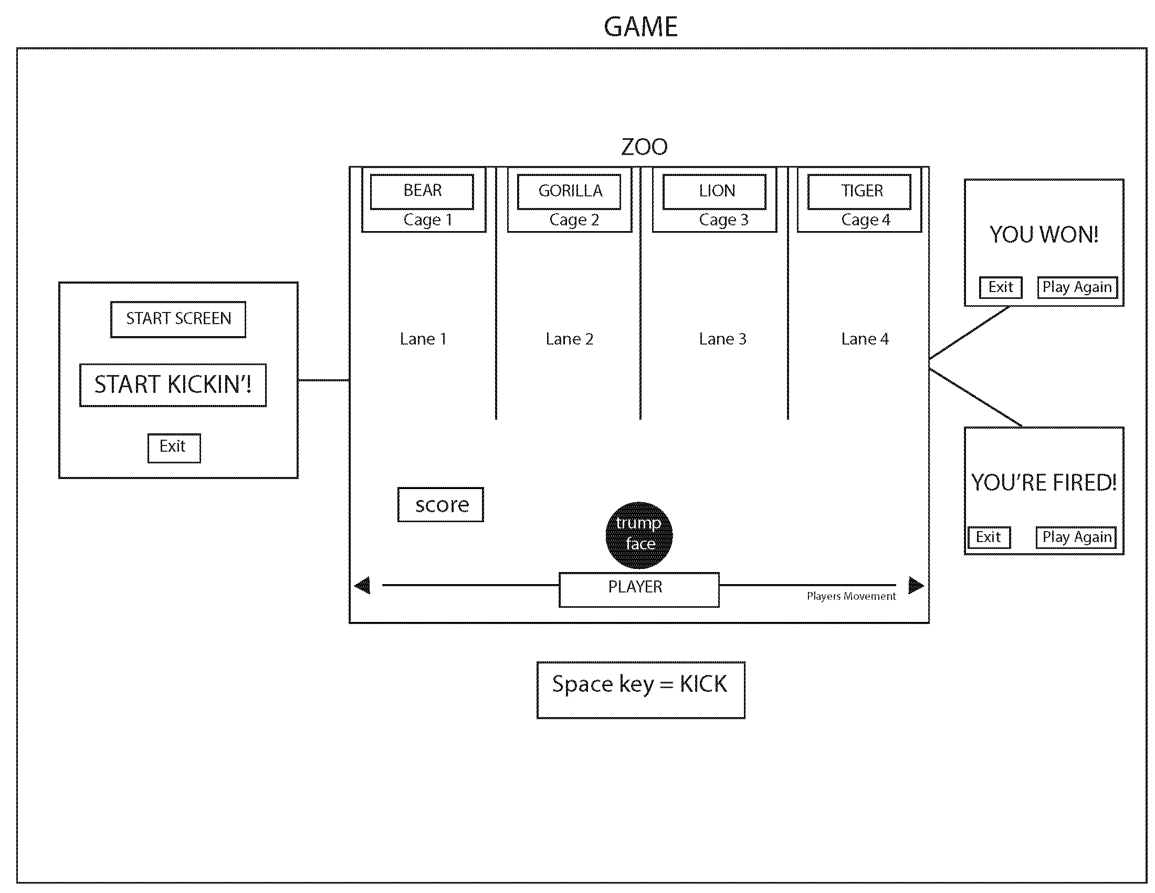
Game User Diagram
WonScreen
StartScreen
LostScreen

Slide 11
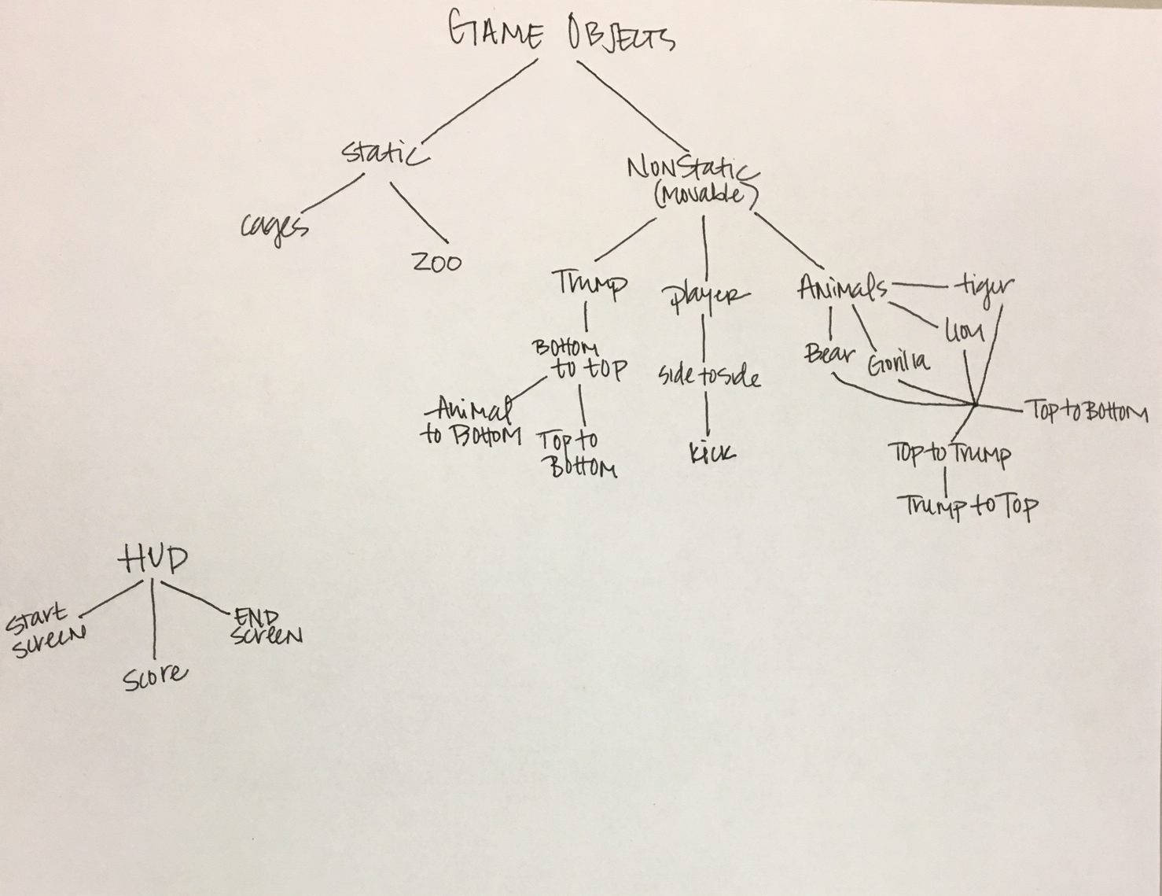
Game Inheritance - Original

Slide 12
Game Inheritance - Final
StartScreen
JS Object{}
GameScreen
Screen
GameObj
HUD
EndScreen
LostScreen
Score
Static
Dynamic
Master
Visible
Invisible
Zoo
Cage
Animal
Trump
Player

